Slide 1
Revised Self-Report Assessment of
Functional Visual Performance
(R-SRAFVP) Application
R-SRAFVP App Preview
Kirk Hedlich
Dr. Byron DeVries
CIS693 Final Project, Fall 2021
Grand Valley State University

Slide 2
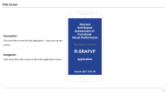
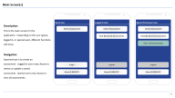
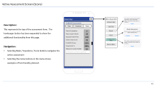
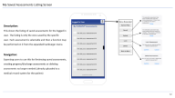
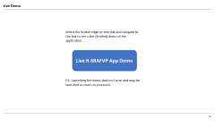
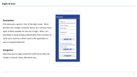
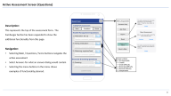
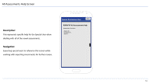
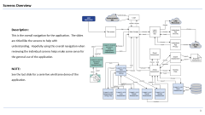
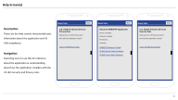
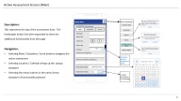
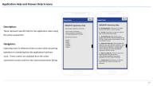
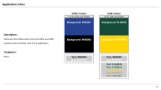
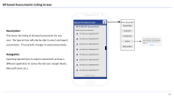
Table of Contents
Overview
Title Screen
Main Screens
About Help Screens
Login
Assessment (Header)
Assessment (Questions)
Assessment (Scores)
Assessment Help Screens
Live Demo
My Saved Assessments
All Assessments
All Assessments Help
App Colors

Slide 3
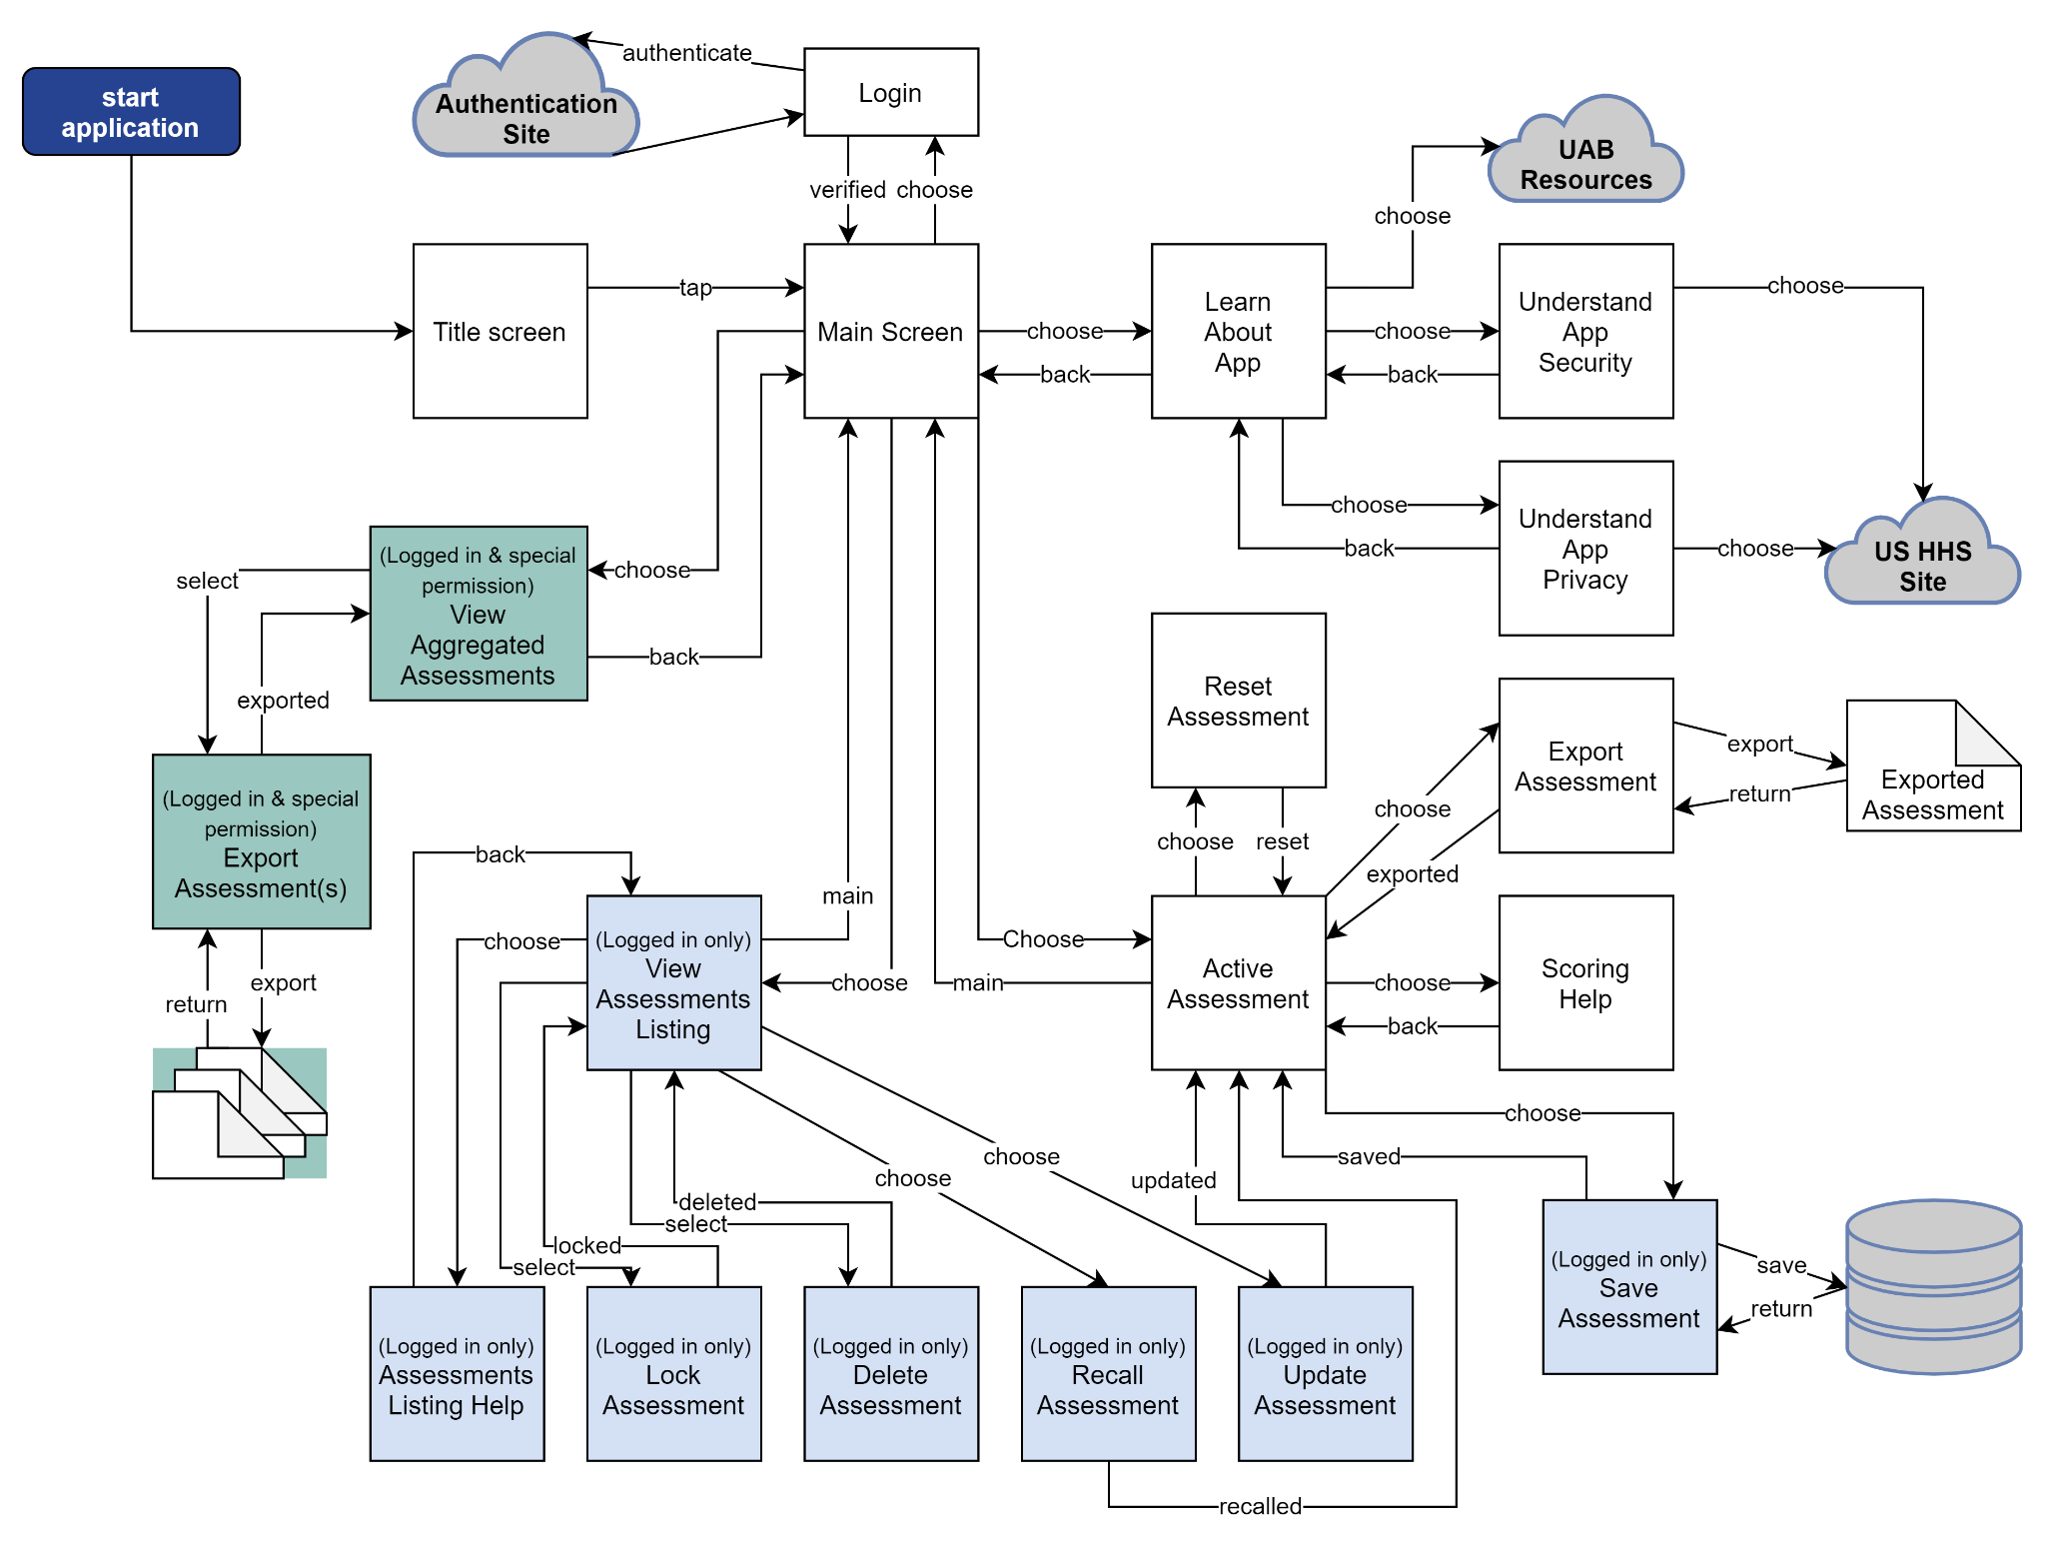
Screens Overview
Description:
This is the overall navigation for the application. The slides are titled like the screens to help with understanding. Hopefully using this overall navigation when reviewing the individual screens helps make some sense for the general use of the application.
NOTE:
See the last slide for a semi-live wireframe demo of the application.

Slide 4
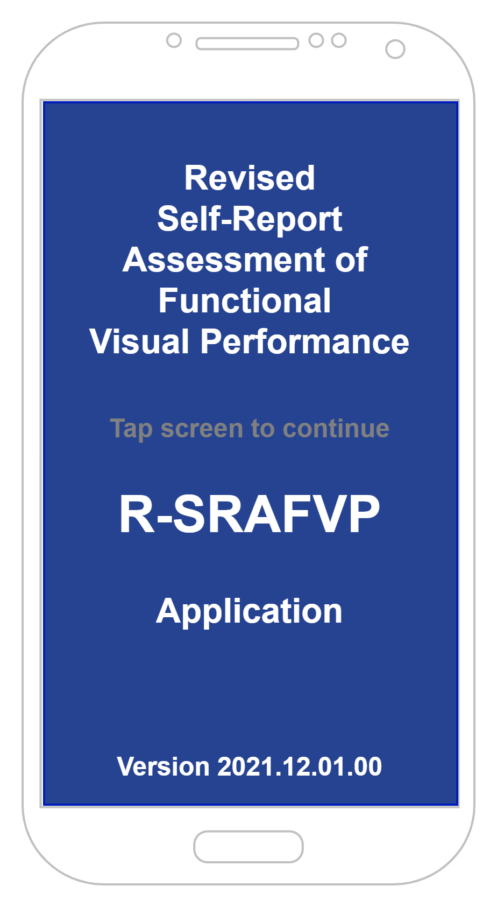
Title Screen
Description:
This is the first screen for the application. Once you tap the screen
Navigation:
User move from this screen to the main application screen.

Slide 5
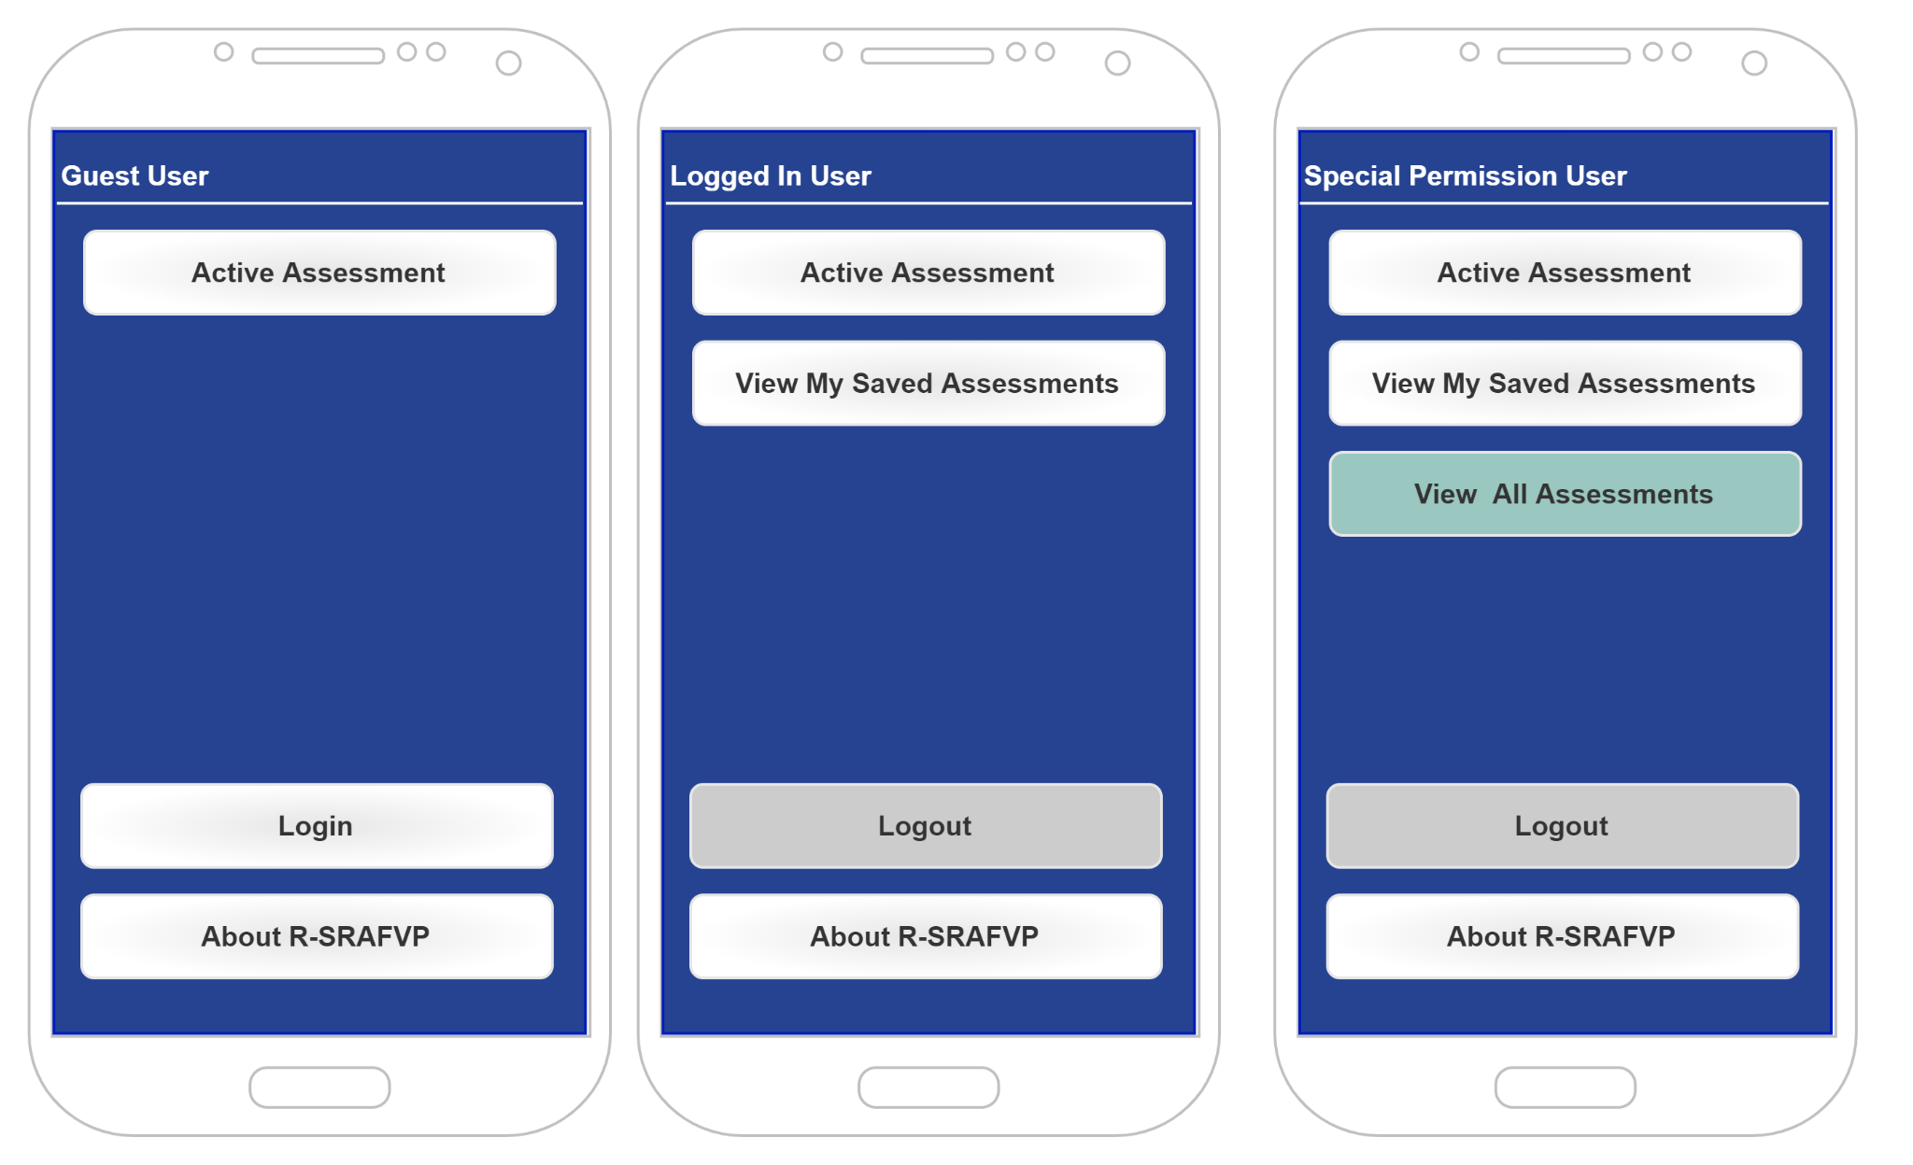
Main Screen(s)
Description:
This is the main screen for the application. Depending on the user (guest, logged in, or special user), different functions will show.
Navigation:
Expected use is to create an assessment. Logged in users may choose to review or update a saved assessment. Special users may choose to view all assessments.

Slide 6
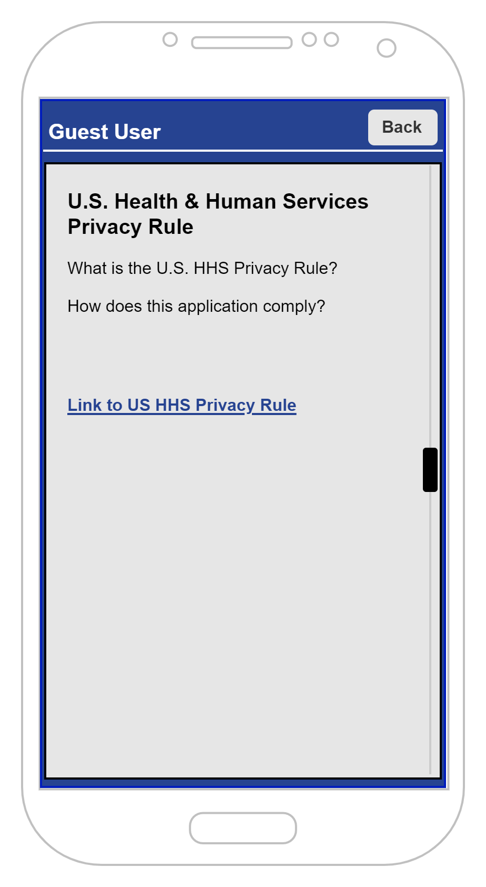
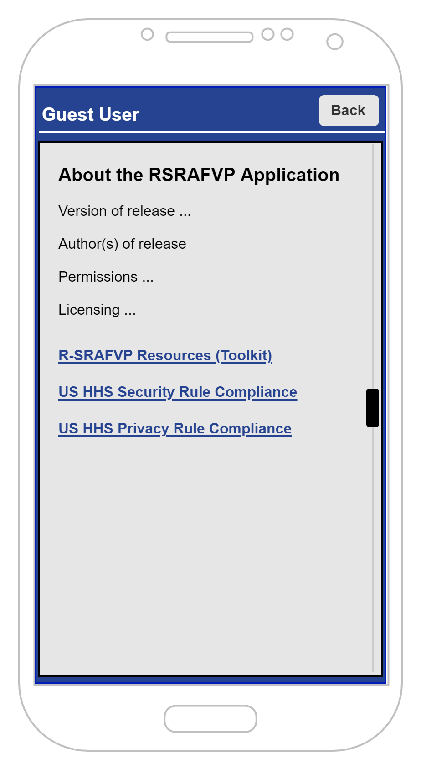

Help Screen(s)
Description:
These are the help screens that provide basic information about the application and US HHS compliance.
Navigation:
Expecting users to use this for reference about the application or understanding about how the application complies with the US HHS Security and Privacy rules.

Slide 7
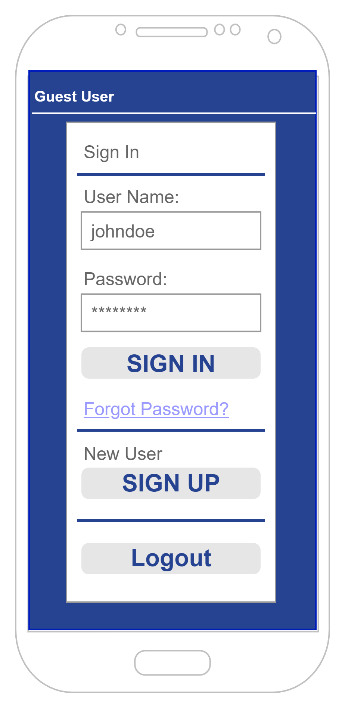
Login Screen
Description:
This represents a generic view of the login screen. Most providers (ex: Google, Facebook, Yahoo, etc.) will have these types of fields available for the user to login. Note, I am intending on using existing authentication from providers to verify users and then redirect back to this application to save on programming time.
Navigation:
Expecting users to login using their preferred provider (ex: Google, Facebook, Yahoo, Microsoft, etc.).

Slide 8
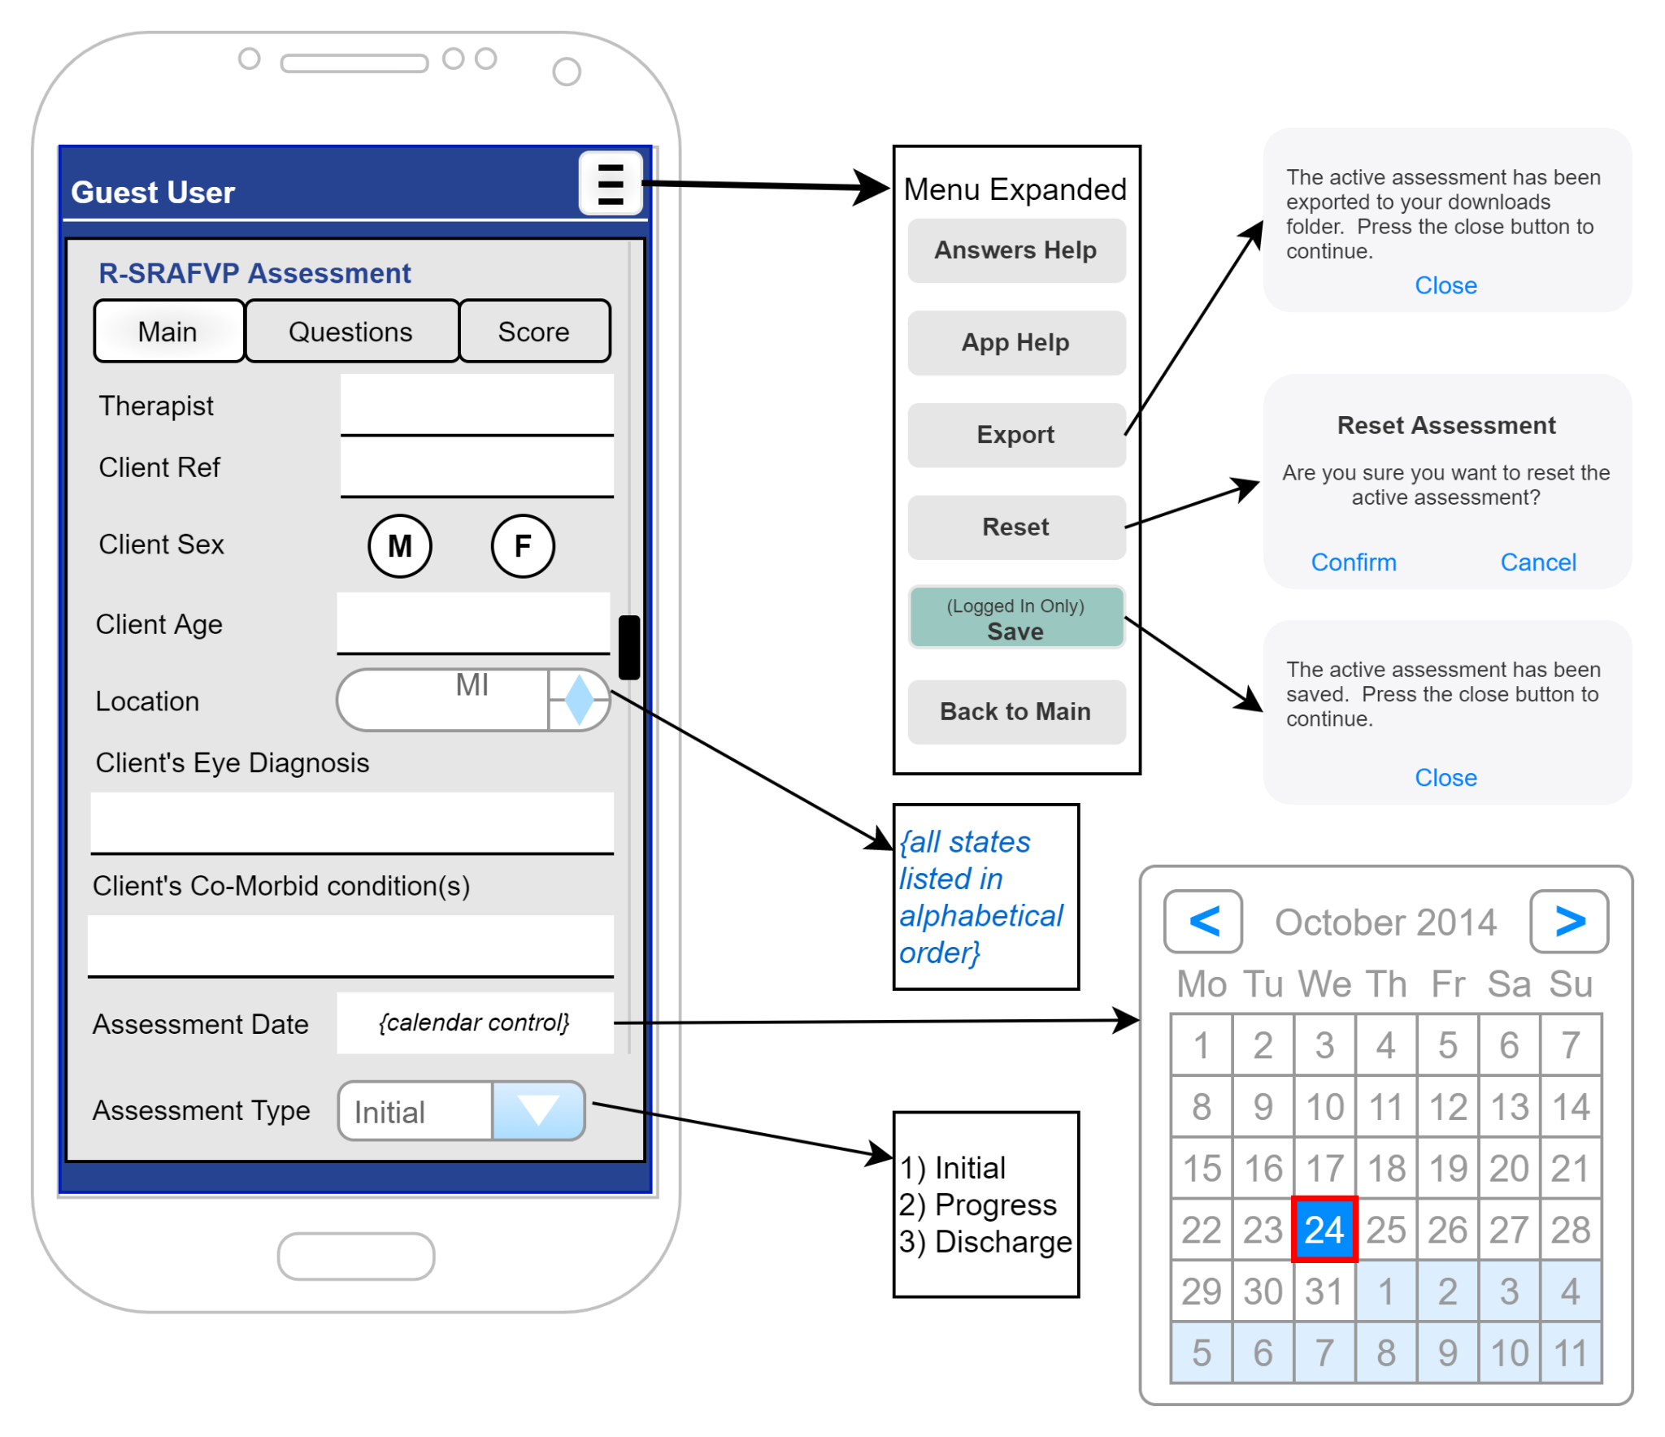
Active Assessment Screen (Main)
Description:
This represents the top of the assessment form. The hamburger button has been expanded to show the additional functionality from this page.
Navigation:
Selecting Main / Questions / Score buttons navigates the active assessment
Selecting Location / Calendar brings up the popup examples
Selecting the menu buttons in the menu shows examples of functionality planned.

Slide 9
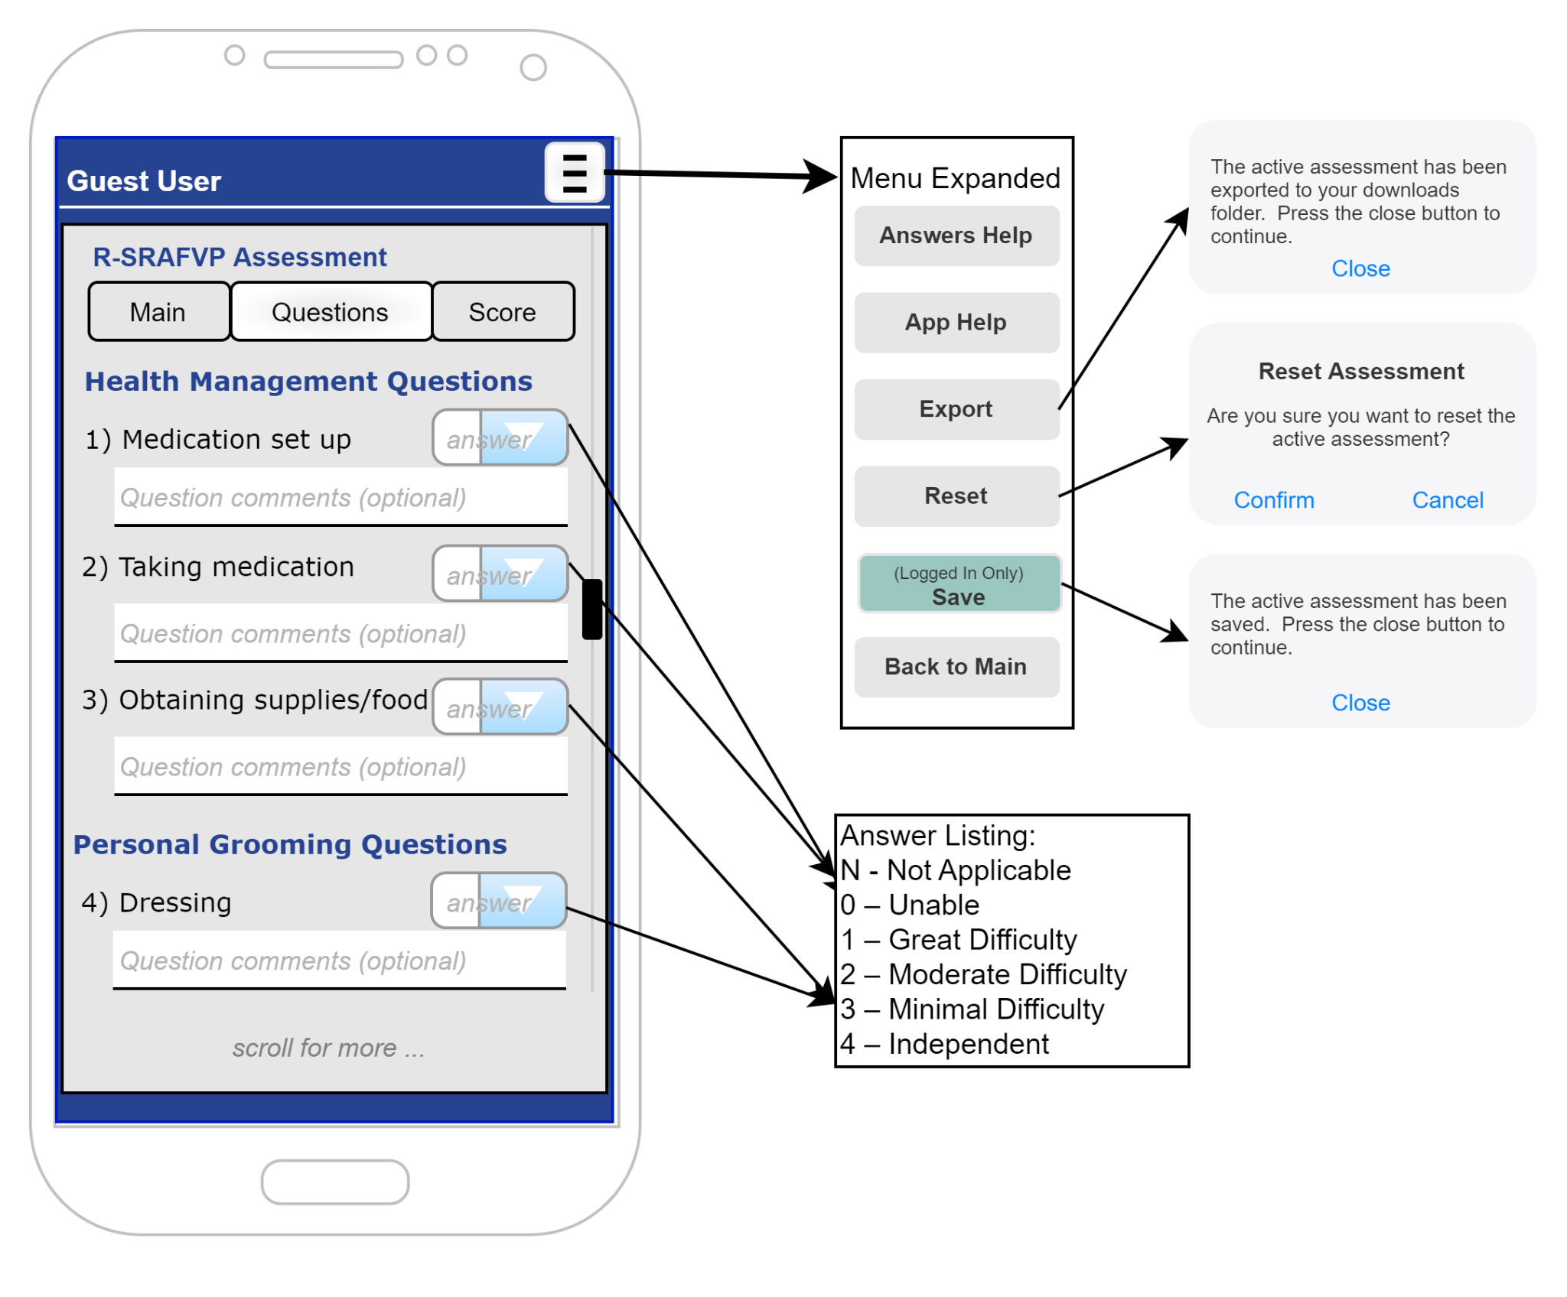
Active Assessment Screen (Questions)
Description:
This represents the top of the assessment form. The hamburger button has been expanded to show the additional functionality from this page.
Navigation:
Selecting Main / Questions / Score buttons navigates the active assessment
Select Answers for what an answer dialog would contain
Selecting the menu buttons in the menu shows examples of functionality planned.

Slide 10
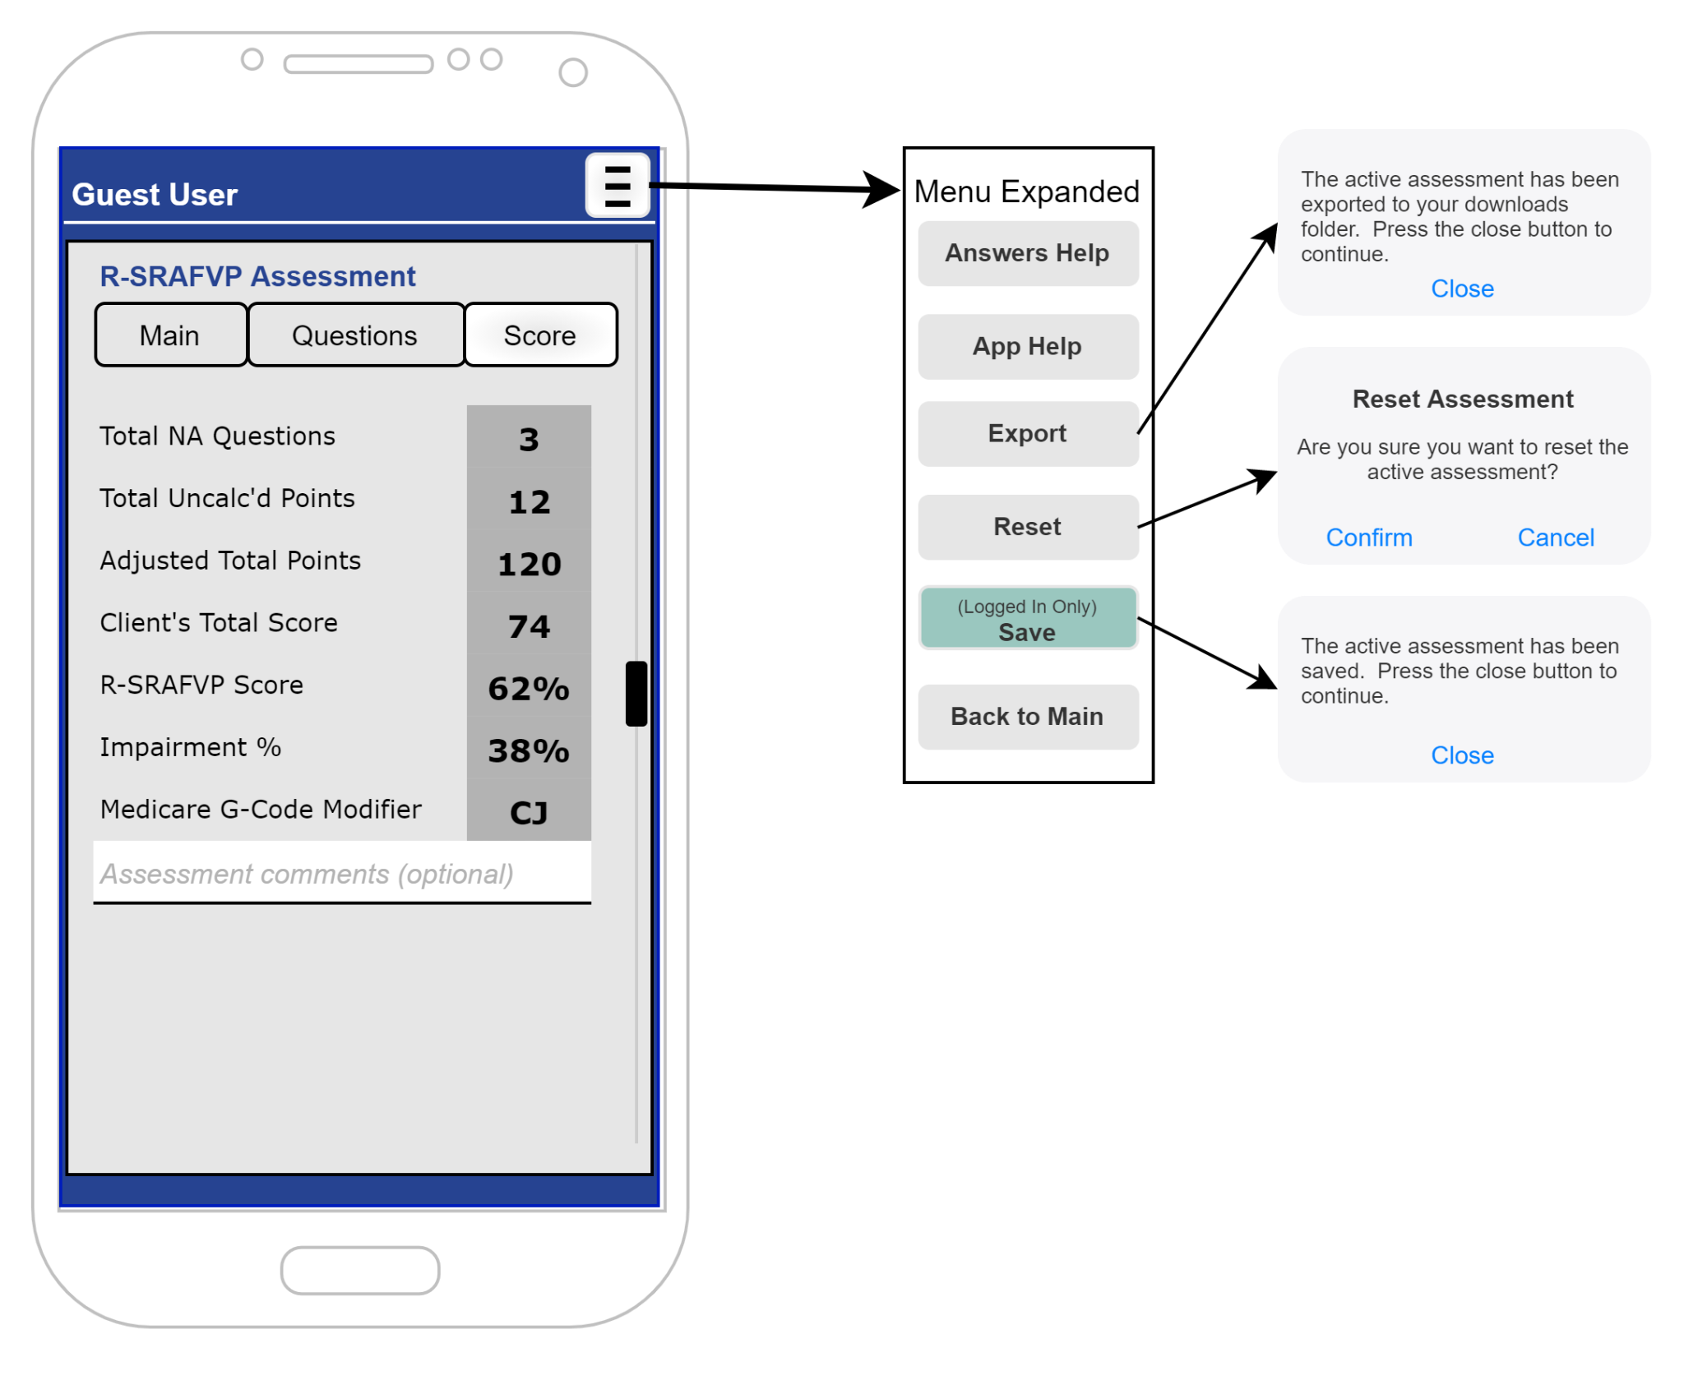
Active Assessment Screen (Score)
Description:
This represents the top of the assessment form. The hamburger button has been expanded to show the additional functionality from this page.
Navigation:
Selecting Main / Questions / Score buttons navigates the active assessment
Selecting the menu buttons in the menu shows examples of functionality planned.

Slide 11
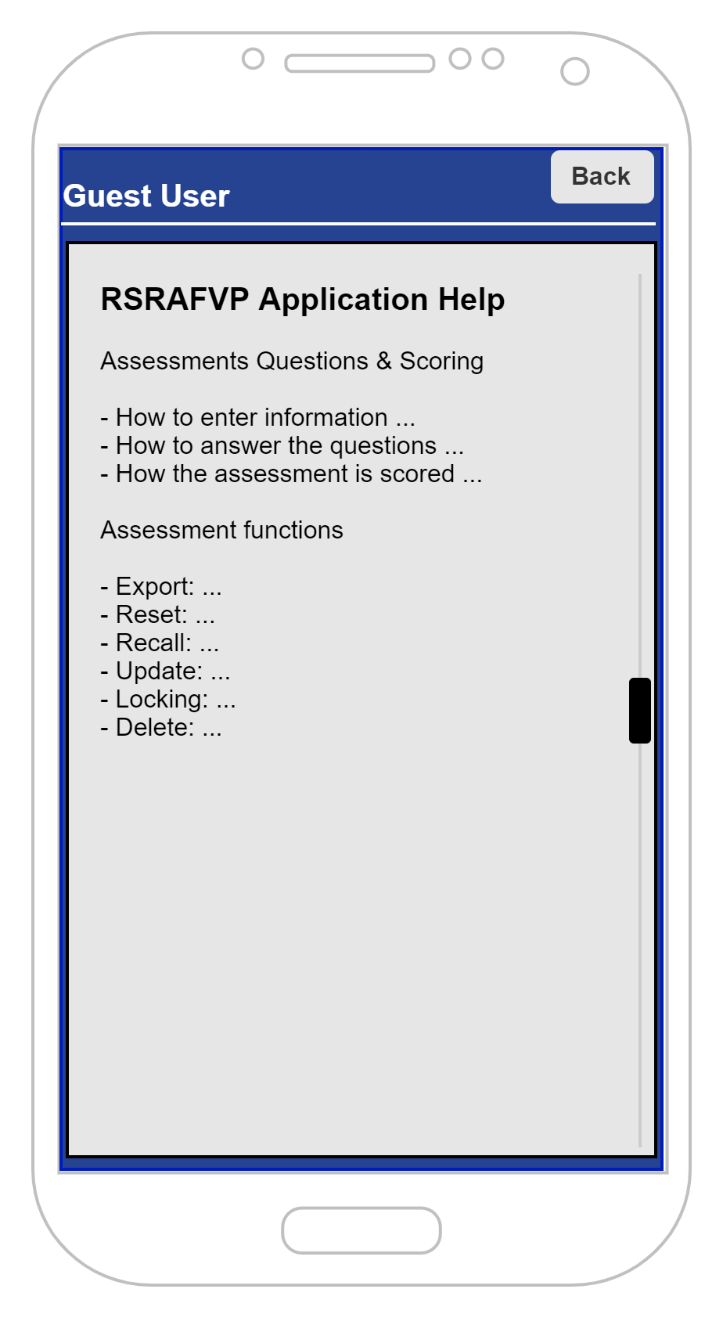
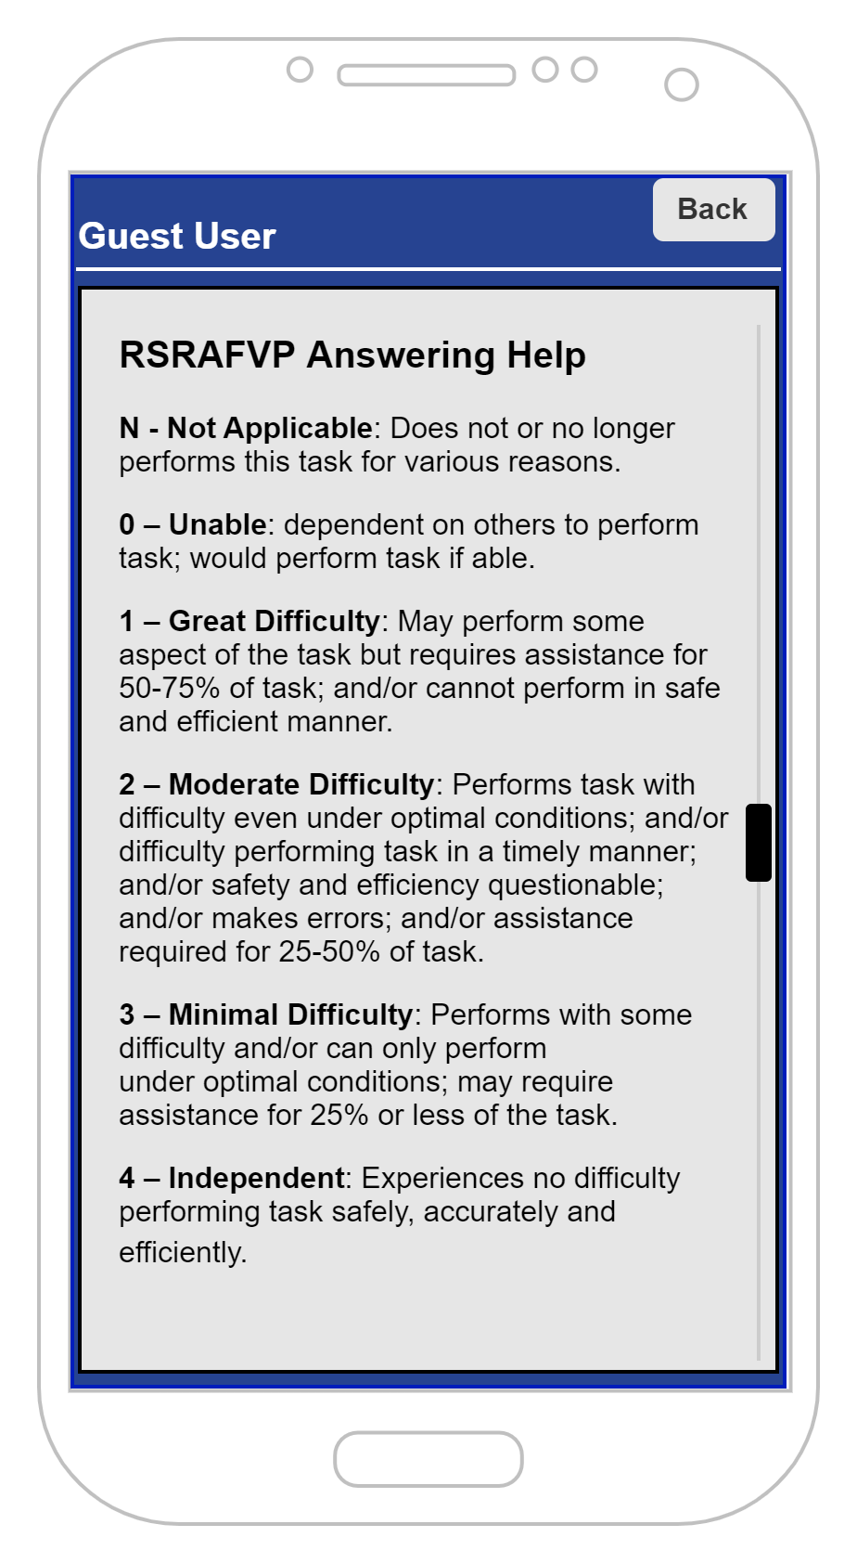
Application Help and Answer Help Screens
Description:
These represent specific help for the application when using the active assessment.
Navigation:
Expecting users to reference these screens while answering questions or wondering how the application functions work. These screens are available from the active assessment screens and the view saved assessments listing.

Slide 12
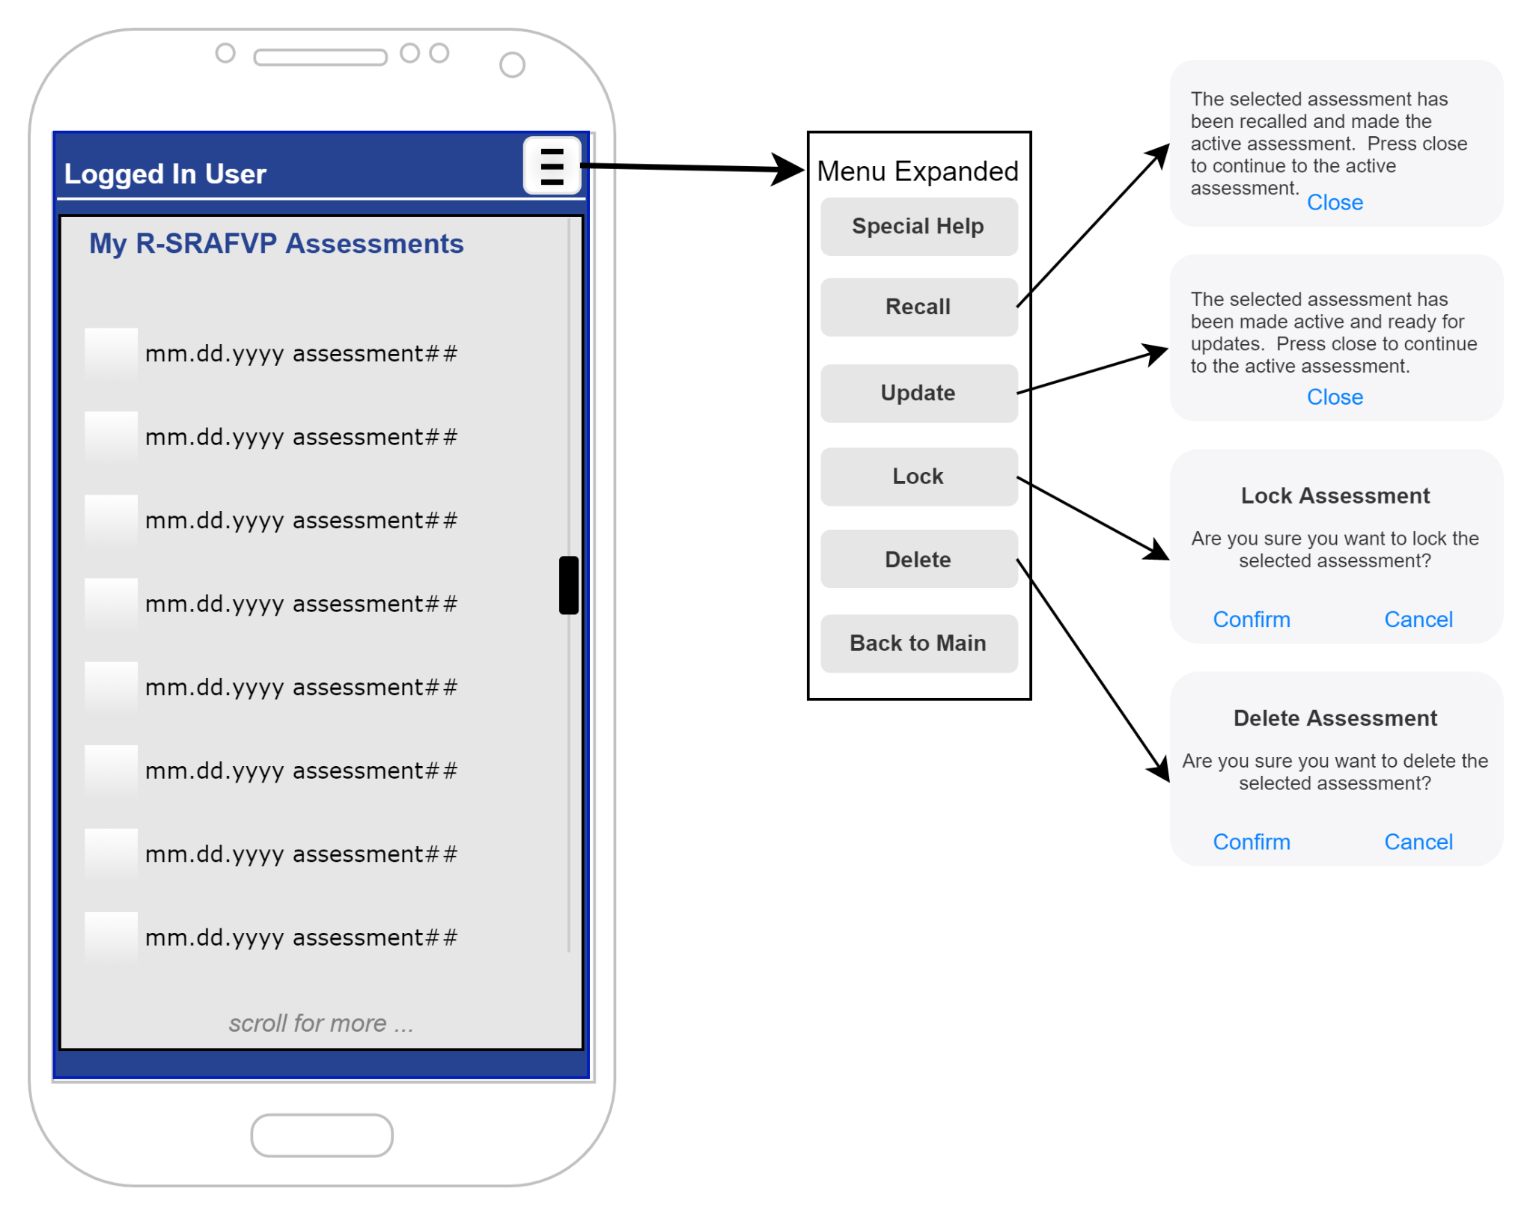
My Saved Assessments Listing Screen
Description:
This shows the listing of saved assessments for the logged in user. The listing is only the ones saved by the specific user. Each assessment is selectable and then a function may be performed on it from the expanded hamburger menu.
Navigation:
Expecting users to use this for Reviewing saved assessments, creating progress/discharge assessments or deleting assessments no longer needed (already uploaded to a medical record system for the patient)

Slide 13
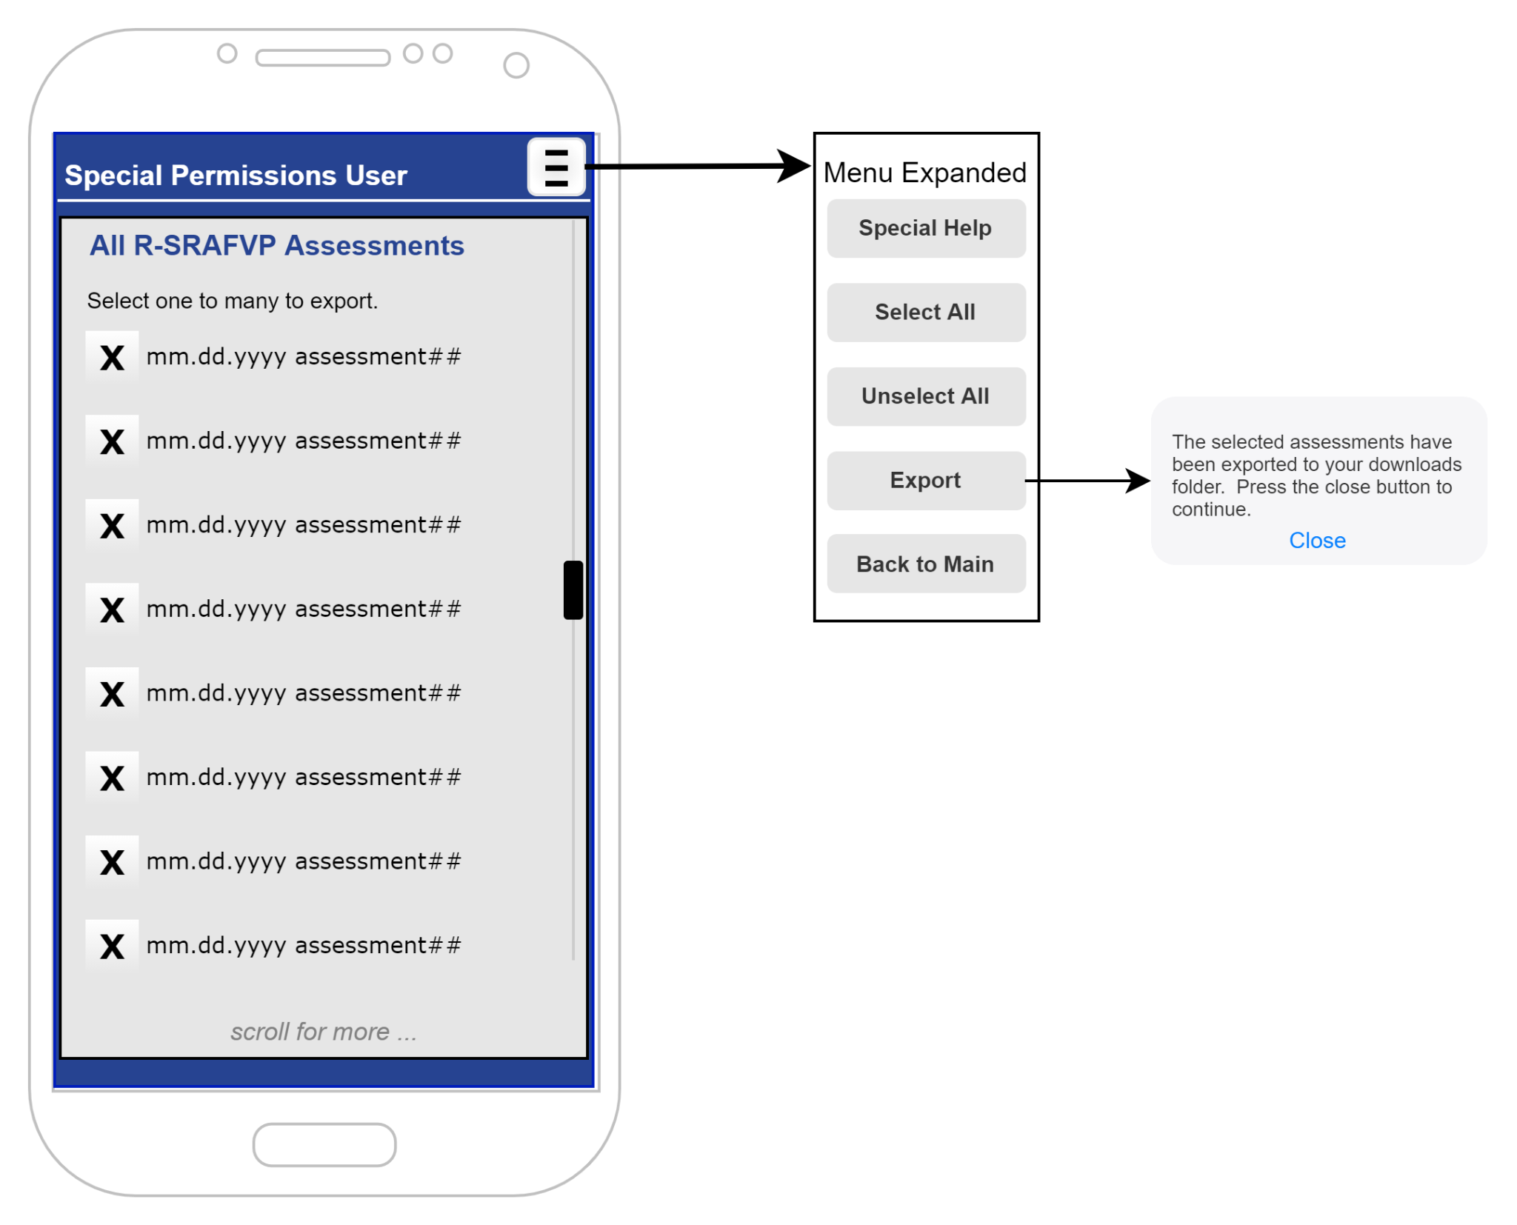
All Saved Assessments Listing Screen
Description:
This shows the listing of all saved assessments for any user. The Special User will only be able to select and export assessments. This prevents changes to saved assessments.
Navigation:
Expecting Special Users to export assessments and use a different application to review the data (ex: Google Sheets, Microsoft Excel, etc.).

Slide 14
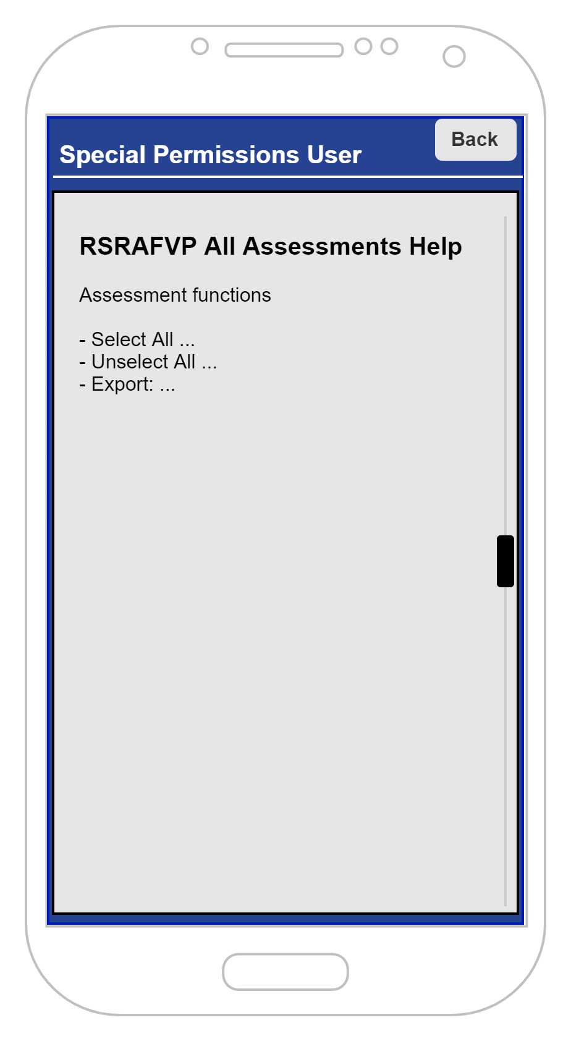
All Assessments Help Screen
Description:
This represents specific help for the Special User when dealing with all of the saved assessments.
Navigation:
Expecting special users to reference this screen while working with exporting assessments for further review.

Slide 15
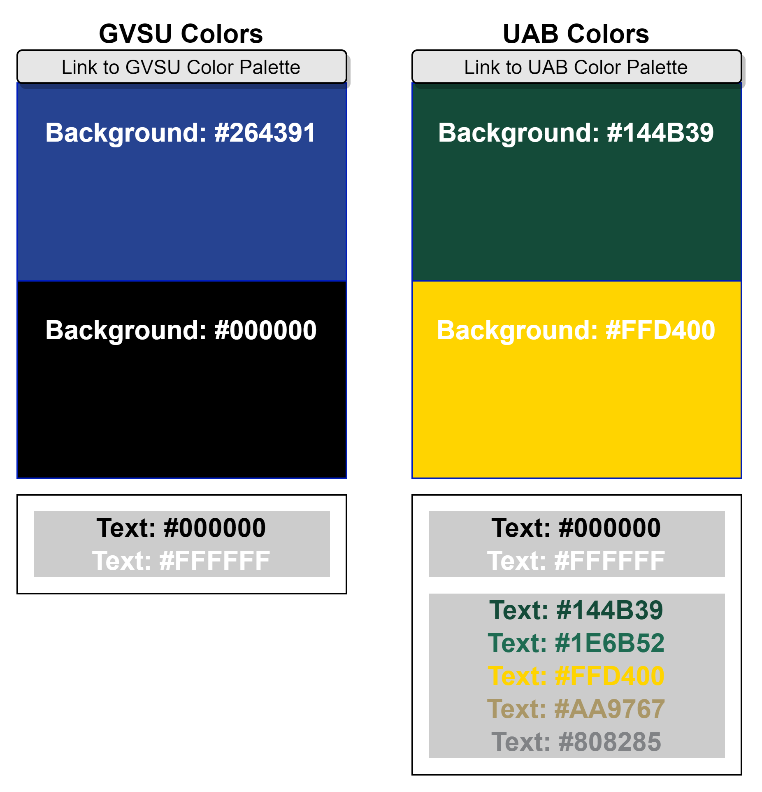
Application Colors
Description:
These are the official colors from the GVSU and UAB websites that would be used in the application.
Navigation:
None.

Slide 16
Live Demo
Select the button edge or text link and navigate to the link to see a live (limited) demo of the application.
Live R-SRAFVP App Demo
P.S. Launching the demo does no harm and may be launched as much as you want.

